Slide 1

FLIPKART CLOTHES ANALYSIS
KANDHATI SAIVARSHA REDDY
Batch-442

Slide 2
Agenda
Business Problem
Business Objective
Problem Statement
Data Preprocessing
Analysis and Interpretation
Hypothesis Testing
Recommendations
Challenges
Conclusion

Slide 3
Business Problem
The Flipkart clothing dataset contains unstructured product information scraped from multiple web pages. The challenge is to transform this raw data into meaningful insights by analyzing pricing patterns, discount behavior, brand influence, and customer ratings. The goal is to provide actionable insights that help Flipkart improve its pricing strategy and customer experience.

Slide 4
Business Objective
The main objective of this project is to perform Exploratory Data Analysis (EDA) on Flipkart clothes data in order to:
Analyze price distribution across different clothing products
Study discount patterns offered by different brands
Identify popular brands and product categories
Compare original price vs selling price
Generate actionable insights to support business decision-making

Slide 5
Problem Statement
The Flipkart clothes data is large, unstructured, and spread across multiple web pages, making it difficult to directly use for analysis.
Therefore, it is necessary to:
Extract important product details such as product name, brand, product type, price, original price, and discount
Clean and preprocess the data for analysis
Analyze the data to identify patterns, trends, and relationships
Without performing Exploratory Data Analysis (EDA), Flipkart cannot make data-driven decisions regarding pricing strategies, discount offers, and product positioning.

Slide 6
Data Preprocessing
Raw Flipkart clothes data collected through web scraping
Data contained missing values, duplicates, and inconsistent formats
Data preprocessing was performed to make the dataset suitable for analysis
Data Loading & Understanding
Imported required libraries Pandas, Numpy
Created Data Frame from scraped data
Checked dataset structure using:
head() describe() info()
Identified data types and missing values

Slide 7
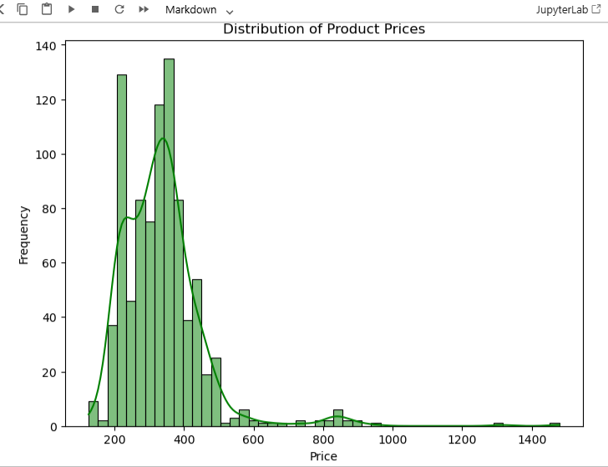
Analysis and Interpretation
Univariate Analysis
1.What is the most common price range of products?
Most products are priced between ₹300 and ₹400, which is the most frequent price range.
2. Around which value is the highest concentration observed?
The highest concentration of products is observed around ₹350, indicating it as the modal price.

Slide 8
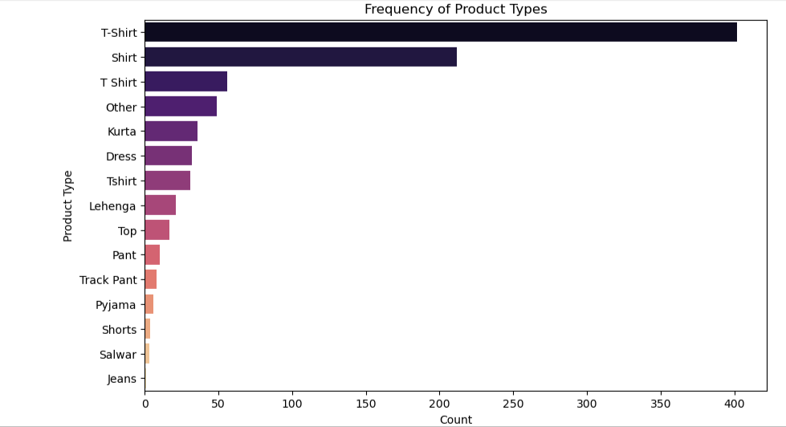
1.Which product type is the most frequent in the dataset?
T-Shirt is the most frequent product type, having the highest count among all categories.
2. Which product types are least represented?
Jeans, Salwar, and Shorts are the least represented product types with very low frequencies.
3. What does the distribution of product types indicate?
The distribution is highly imbalanced, with a large concentration of products in the T-Shirt and Shirt categories.

Slide 9
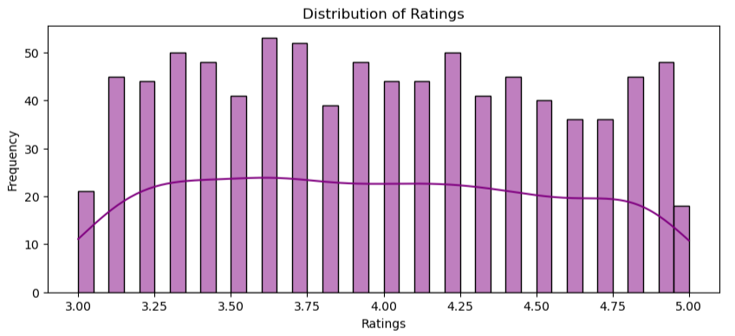
1.What is the common rating range observed?
Most product ratings lie between 3.5 and 4.5, indicating generally positive customer feedback
2.What does the peak of the histogram indicate?
The peak indicates the most frequent rating range, which is around 3.5 to 4.0.
3.What business insight can be drawn from this distribution?
Most products receive good customer ratings, suggesting satisfactory product quality and customer experience.
.

Slide 10
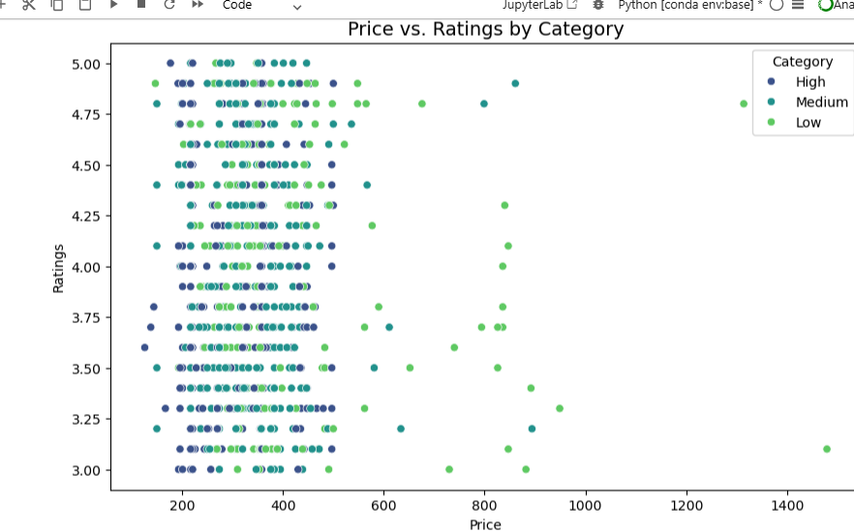
Bivariate Analysis
1.Is there a strong relationship between price and ratings?
No strong linear relationship is observed. Ratings remain mostly between 3 and 5 across all price levels.
2. Where are most data points concentrated?
Most products are concentrated in the ₹150–₹500 price range with ratings between 3.5 and 4.5.
3.What conclusion can be drawn from this graph?
Price and ratings have a weak correlation, and customer satisfaction is influenced more by product quality than by price alone.

Slide 11
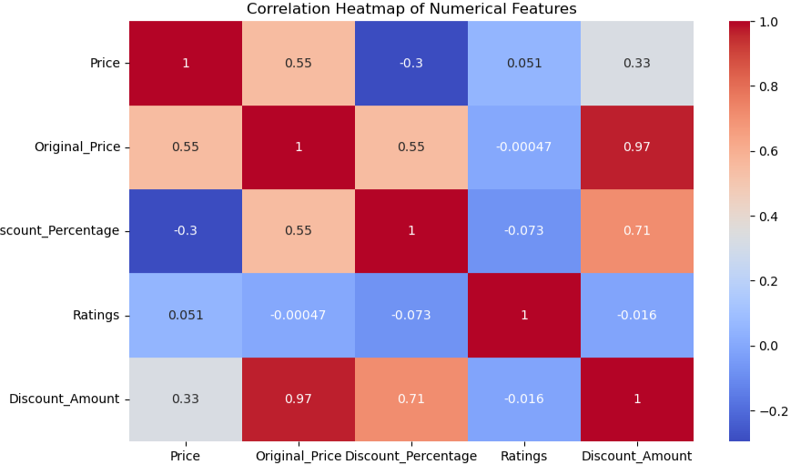
Multi variate analysis
1.Which two variables have the strongest positive correlation?
Original Price and Discount Amount show the strongest positive correlation (0.97).
2.What is the correlation between Price and Original Price?
Price and Original Price have a moderate positive correlation (0.55).
3.What is the relationship between Price and Discount Percentage?
Price and Discount Percentage have a negative correlation (-0.30), meaning higher-priced products tend to have slightly lower discount percentages.

Slide 12
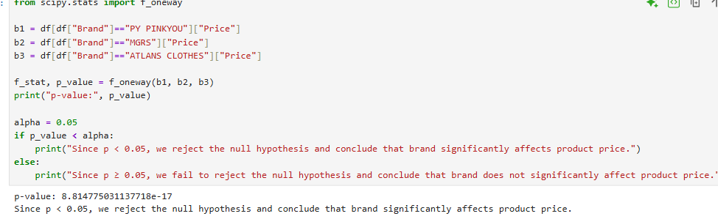
The statistical test shows that product price varies significantly across brands.
This indicates that brand value plays an important role in pricing strategy.
Certain brands are able to command higher prices, while others compete in lower price ranges.
Customers are willing to pay different prices based on brand perception and trust.
Hypothesis Testing

Slide 13
Recommendations
Focus more on mid-range priced products, as they form the largest customer segment.
Develop brand-specific pricing strategies, since brand significantly impacts product price.
Increase promotions for low-performing brands to improve visibility and sales.
Optimize discount levels based on product type, as discount patterns vary across categories.
Maintain product quality across all price segments, since ratings are not strongly related to price.

Slide 14
Challenges
Data contained missing and inconsistent values (e.g., multiple labels for the same product type)
Web-scraped data may change frequently due to dynamic website content.
Some products had no ratings, limiting customer satisfaction analysis.
Brand and product type distributions were highly imbalanced, affecting comparisons.
Discount and price values were in string format, requiring extensive preprocessing..

Slide 15
Conclusion
The Flipkart clothes dataset was successfully collected using web scraping techniques.
Exploratory Data Analysis revealed that mid-range products dominate the market.
Hypothesis testing confirmed that brand significantly affects price, while ratings are weakly related to price.
Discount strategies vary by product type and influence selling prices.
Overall, customer satisfaction depends more on product quality than on price.

Slide 16

THANK YOU

